Slide 1
DYEHARD with REFLECTION in JAVA
Teaching Inheritance using Real Time Simulations with GTCS

Slide 2

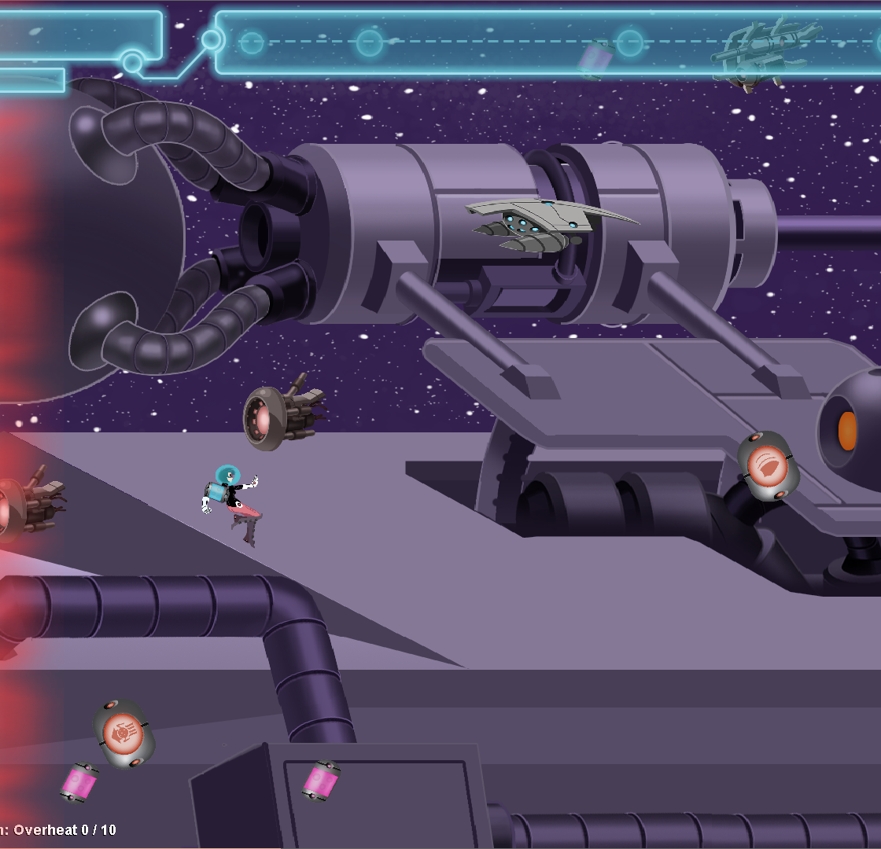

What is dyehard?
Simulation in which the player’s objective is to survive hordes of debris and space enemies
“power-ups” to boost survivability
Collision detection between Enemies and players
Debris and enemies can be dyed by the hero’s gun
One of six simulations built by GTCS (Game Themed Computer Science)
Created Space Smasher, Lynx, Ghost Light, Corrupted, and Hug the Line
“Integrate casual game content into introductory programming courses with minimum impact on their existing curriculum”
Notes:
Dyehard is a game with many programming elements featured that are used in labs to teach concepts to students in a novel way.

Slide 3
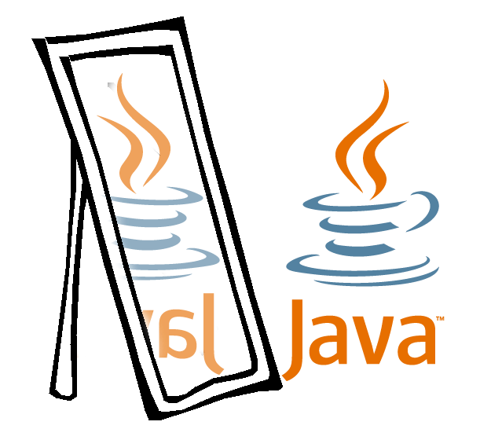
WHAT IS REFLECTION IN JAVA?
“The process of examining or modifying the run time behavior of a class at run time.”
Java.lang.reflection
Allows code to be debugged dynamically.
Allows ability to force programs into a specific state
Allows the invocation of known methods, but unknown classes
Excellent for class exploration, getters/setters validation, field verification, and inheritance hierarchy exploration
Note: It is another class that reflects on a class.

Slide 4
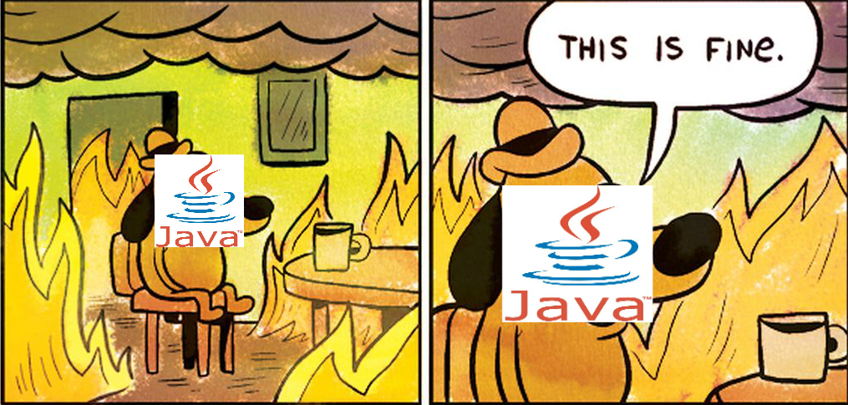
Reflection drawbacks
High Performance Overhead
JVM cannot optimize code since types are dynamically linked and resolved
Security Implications
Requires runtime permissions
Volatile Issues
Turn “final” and “private” into non-final and “public”
Can crash programs easily

Slide 5
Project Objective and goals
Build a tool framework that can evaluate a student’s work and aide in teaching inheritance.
Error-checks on fields, methods, and constructor signatures
Analyzes a class at runtime with minor knowledge of its implementation
Streamline evaluation process for a class’ functionality
For the student, assist in preliminary code submission
Update the codebase with comments
Perform bug fixes

Slide 6
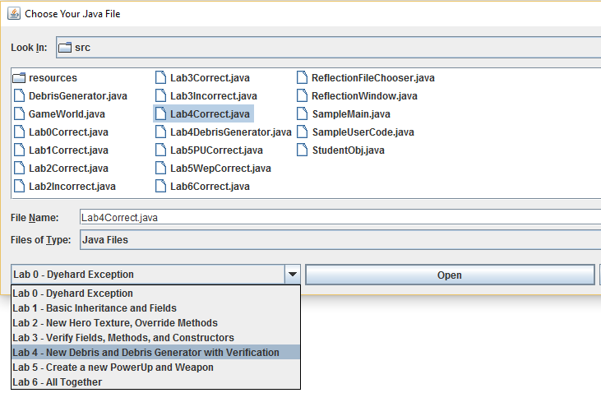

Tool Workflow
Student imports their file into the project workspace
The Tester file (Manages labs and verifying the student code) calls ClassReflector's constructor
ClassReflector collects the specified class's constructors, methods, and fields.
With the ClassReflector object, you can:
Compare it with an array of another set of fields/methods/constructors
Compare it with another ClassReflector object (of another .java file)
Check to see if a certain field or method is contained
Invoke methods.
Get/Set field values at runtime
GUI to load class file and select lab
Tester File
Student Code

Slide 7
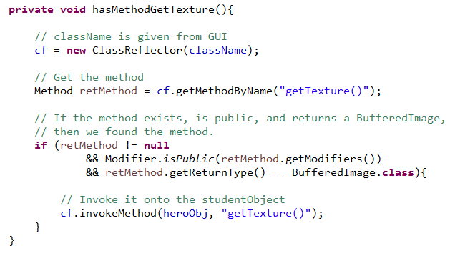
CLASSREFLECTOR EXAMPLE
Objective
Find the given method within a student class based on the signature, and invoke it onto the Hero Object.
“public BufferedImage getTexture()”

Slide 8
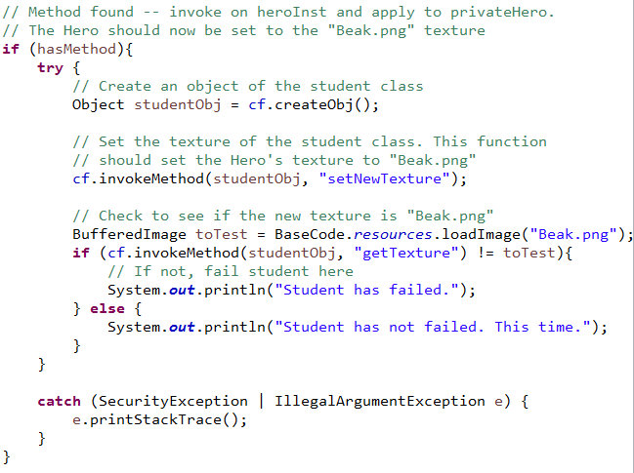
Simple Example: test Texture change
Objective
Student defines method
Evaluator use ClassReflector, creates the student object, and calls method on the object
Evaluator validates that the method is correct

Slide 9


Lab 0
Lab 1
Lab 2
Basic inheritance hierarchy
Declaration of default constructor
Declaration of String-parameter constructor
Inheritance hierarchy
Fields “width” and “height”
Getter/setter methods for each field
Declaration of setSize() method.
Define a new height and width for Hero
Define a new texture for Hero
Default Constructor
Parameterized Constructor that sets the Hero’s center, width, and height.
Getters/setters for texture, center, width, and height

Slide 10

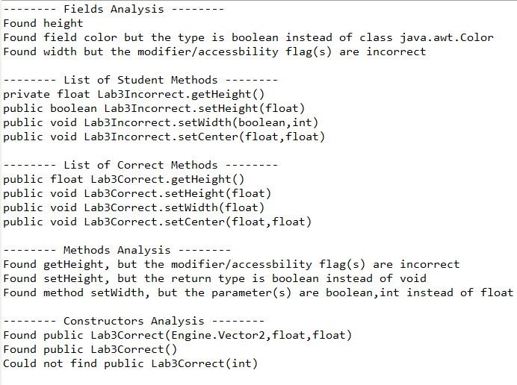
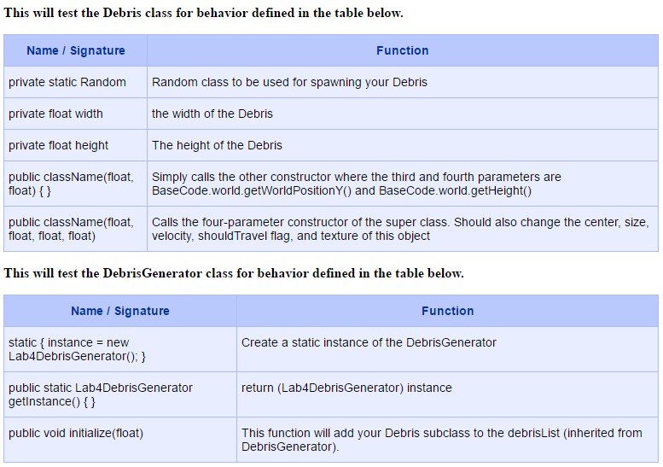

Lab 3
Lab 4
Purpose is to show evaluator how to verify a student class with a “correct” class
Student creates their own Debris subclass and extend the functionality of the Debris-Generator to include their own Debris subclass

Slide 11
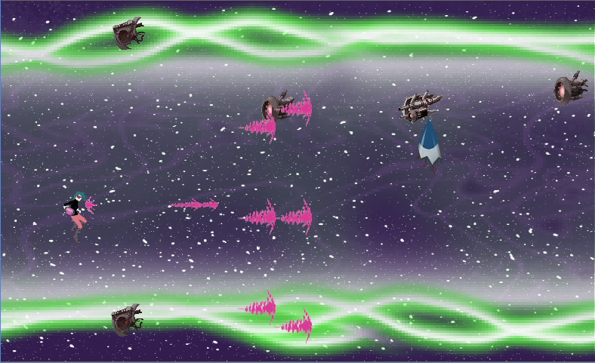




Lab 5
Lab 6
Student creates a new Powerup and Weapon
When Hero collects Powerup, give them the new Weapon
Focuses on method overriding for object behavior
All together – Combines all previous labs to create a whole new level!
Hero
Student Weapon
(oooo)
Student Powerup

Slide 12
results
ClassReflector.java, SampleUserCode.java
Created a usage document
Designed seven labs
How it can be used to teach entry-level coders
How to evaluate a student’s code
Submission to EngageCSEDU for CS1/CS2 students in Fall 2016
“Primary goal is to support the retention of women and other underrepresented groups in undergraduate computer science majors.”
Diversify the programming experience, diversify the computing workforce

Slide 13
Conclusion
Code can be hard to debug
Reflection is powerful and useful in niche situations
When you need reflection, you will know
HUGE thanks to Professor Kelvin Sung and Professor Rob Nash!

